Slide 1


CSE 2040
Programming IV
Lecture #31

Slide 2
Graphical User Interface

Slide 3
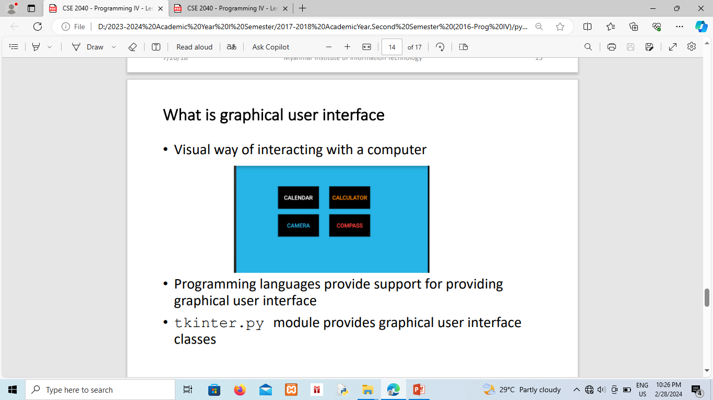

Slide 4
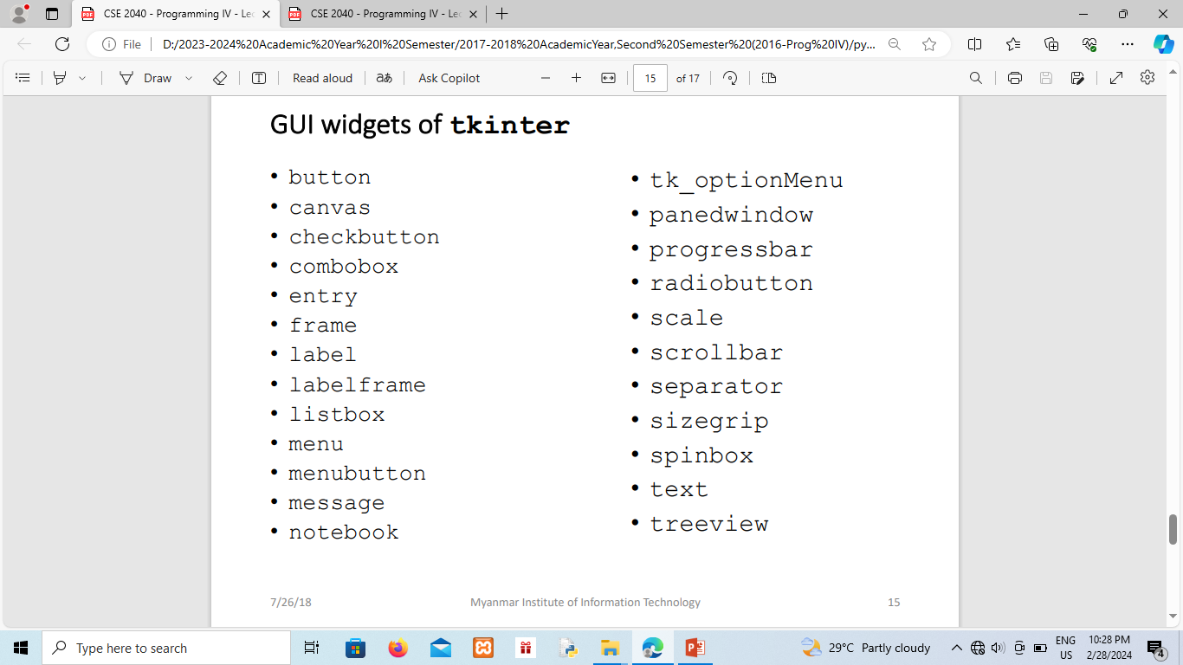

Slide 5
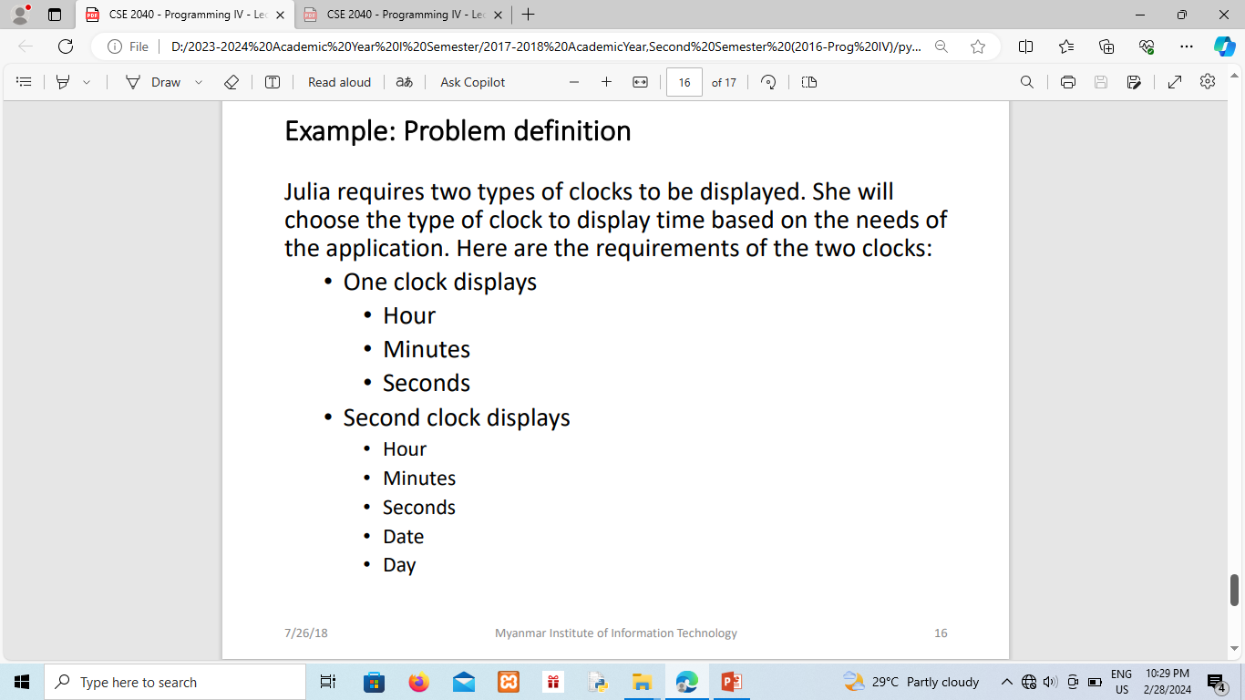

Slide 6
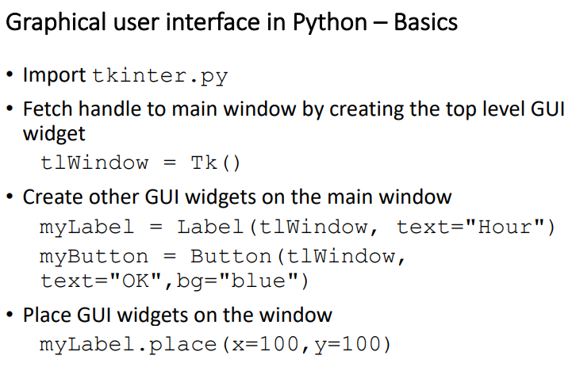
Notes:
NoneType=type(None)
x=None
type(x)
type(x)==NoneType
isinstance(x,NoneType)

Slide 7
Inheritance : example problem

Slide 8
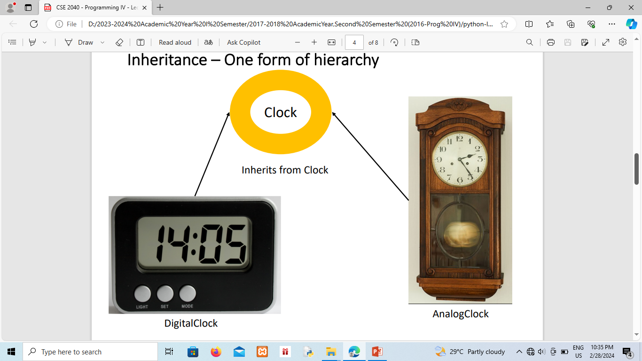
Inheritance – One form of hierarchy
Notes:
NoneType=type(None)
x=None
type(x)
type(x)==NoneType
isinstance(x,NoneType)

Slide 9
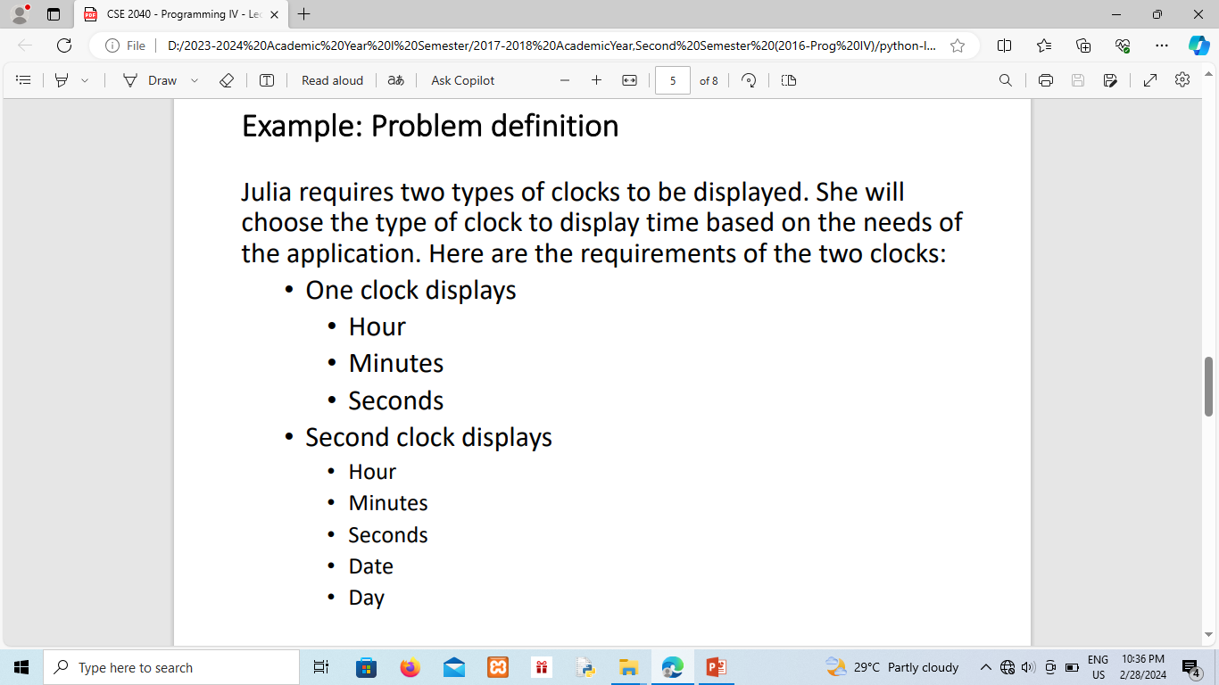

Slide 10
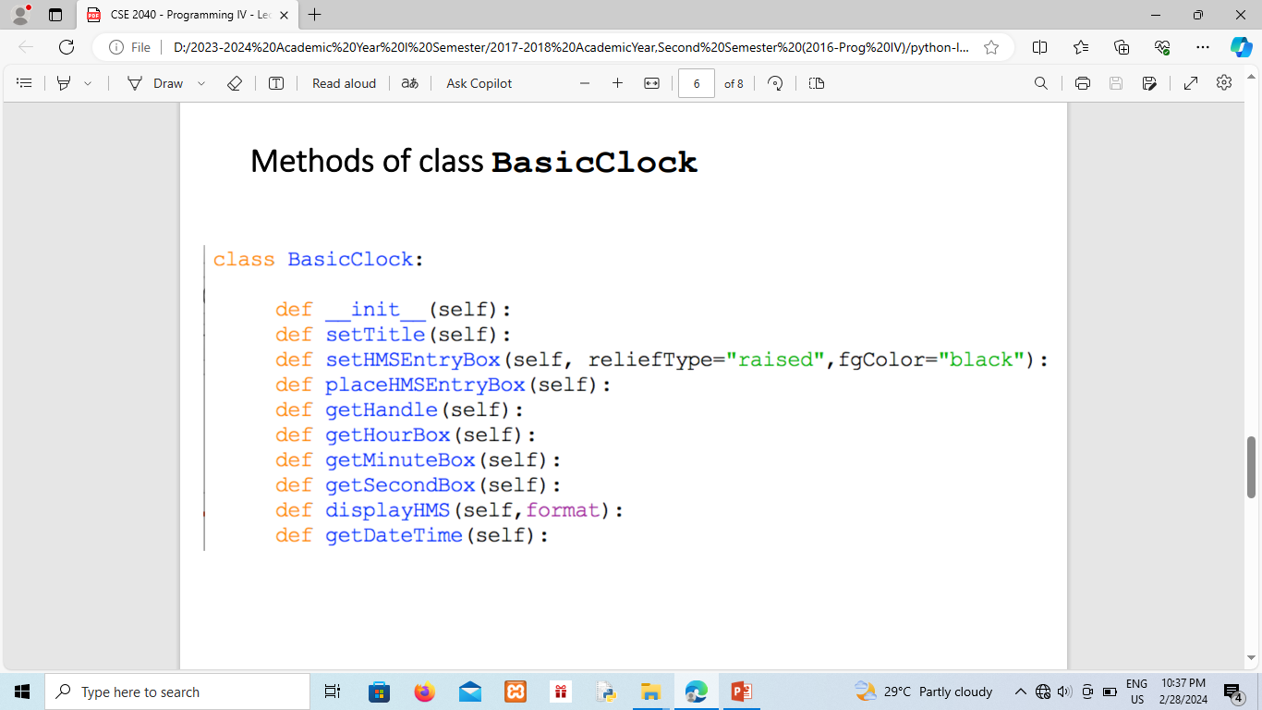

Slide 11
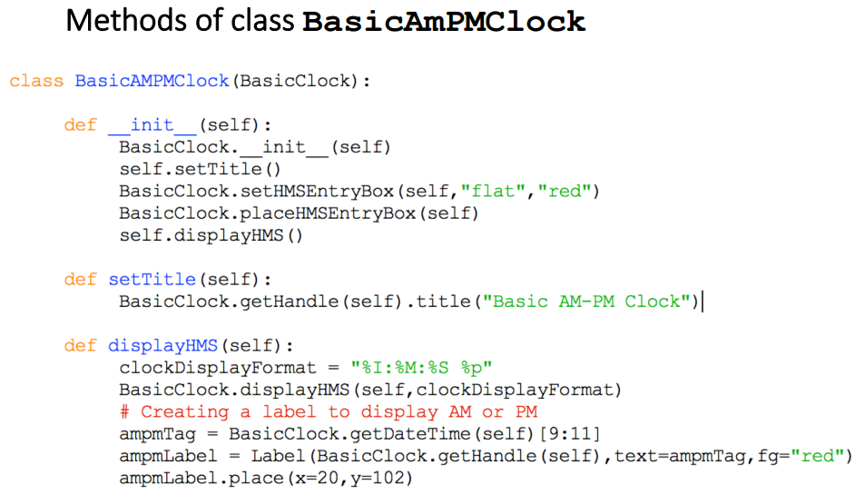

Slide 12
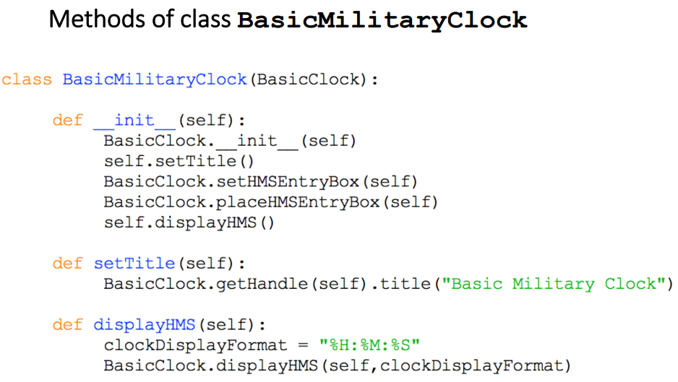

Slide 13
References
Professor Usha lecture slides
Dr. R. Nageswara Rao, Core Python Programming, Second Edition, 2018

